Slide 1

The Railway Reservation System
BY
Devesh Kumar (16624)
Aditya Jaiswal (16602)
Akash Singh (16605)
Bachelor of Technology
In
Information Technology
Under The Supervision Of
Mr. Raushan Kumar Singh
DEPARTMENT OF COMPUTER SCIENCE AND ENGINEERING
KAMLA NEHRU INSTITUTE OF TECHNOLOGY

Slide 2
Presentation Outline
Introduction
Objectives
System Requirements
Software Requirements
Hardware Requirements
Modules
User Case Diagram
E-R Diagram
Screenshots
Testing
Conclusion
References

Slide 3
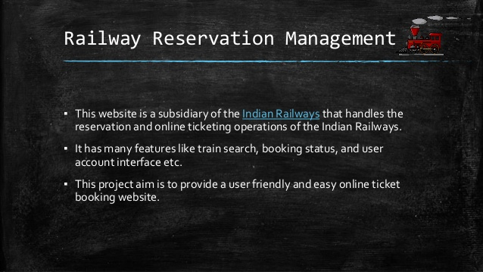
Introduction
In today’s era, IoT(Internet of things) has become much popular around the world. Almost all devices, which are known as smart devices, can connect to the internet and access data from any corner of the world, and whether we like or not it in order to use these services, we need some level of authentication to have access to the services offered by these devices. Examples of the services include; web services like student accounts, administrative platforms, Gmail, Facebook etc.
On of the most common methods of authentication now our days is through password.
Just imaging that a school likes KNIT using a manual account password management system, or not even using an account password management system at all, how dangerous and inconvenient is this?

Slide 4
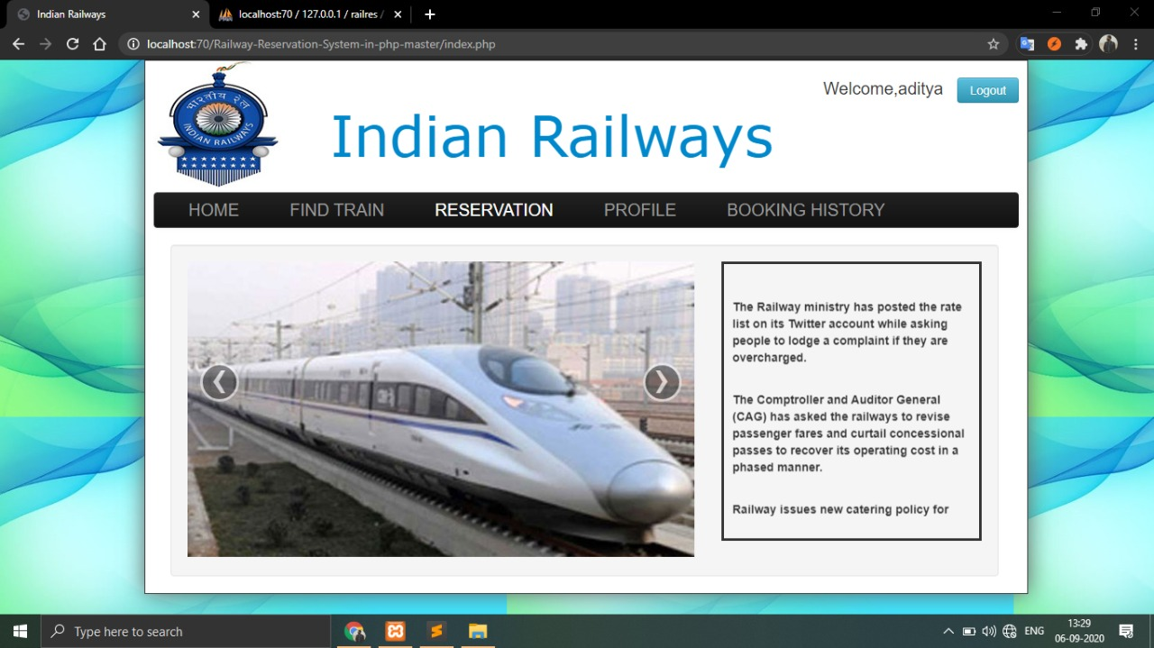
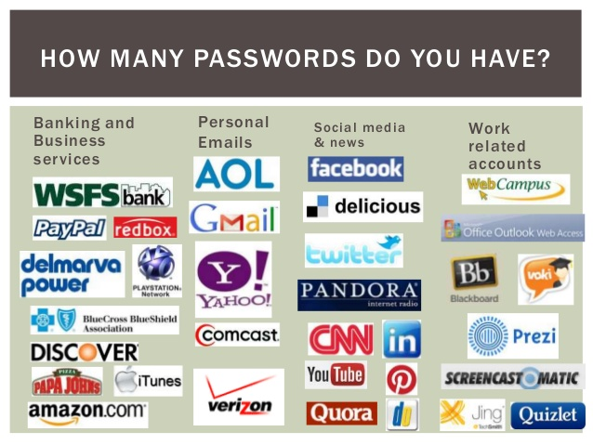

Slide 5
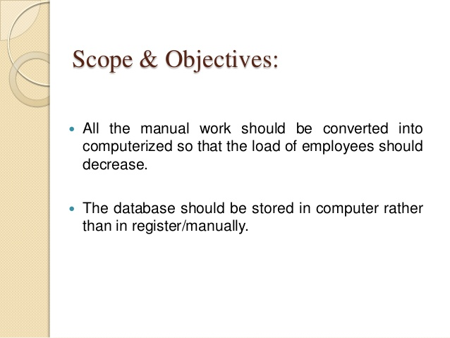
Objective
Managing passwords is a significant problem for most of the people in the modern world. As today’s organization deploys an ever-growing number of complex systems, password management choke help desk systems, cause expensive delays and compromise security.
In this regards, a project has been designed and developed as a web application to
store passwords securely as called as personal password manager.
The purpose with this project is to find out how todays password handling and security works.

Slide 6
System Requirements
Software Requirements
Operating System : Windows
Front End : HTML,CSS
Back End : PHP, Javascript
Database : My Sql

Slide 7
Hardware Requirements Specification
Intel i3 Processor
512 MB RAM
Hard Disk 512 MB
Microsoft Compatible 101 or more Keyboard

Slide 8
Modules
Module 1 : Home
Description :The home modules greets anyone who access the website with the home page where
the person can view and learn about our website and services we offer. The homepage offers
information about our services and they can learn about us as creators.
Sub-Modules:
About us
Services
Contacts
User Interactions
Module 2 : Find Train
Description : This module handles all the information about the trains and their details which
help user to find desired train accordingly.

Slide 9
Module 3 : Reservation
Description :This module helps in reserving the seats in desired train according to need of the user which is sorted in date and time order so that getting a particular train on a particular date becomes easier for the user..
Module 4 : Profile
Module 5 : Booking History
Description: The module helps in reviwing the bookings which is made by the user.User can
easily manage and view all the past bookings done by him in the platform .
Description: The module helps in storing and managing information about user who wishes
to use the platform for booking purposes by providing their details and making a personalised
profile of the user.

Slide 10
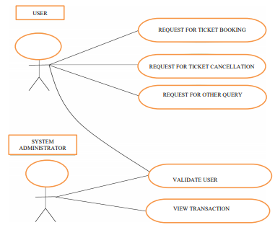
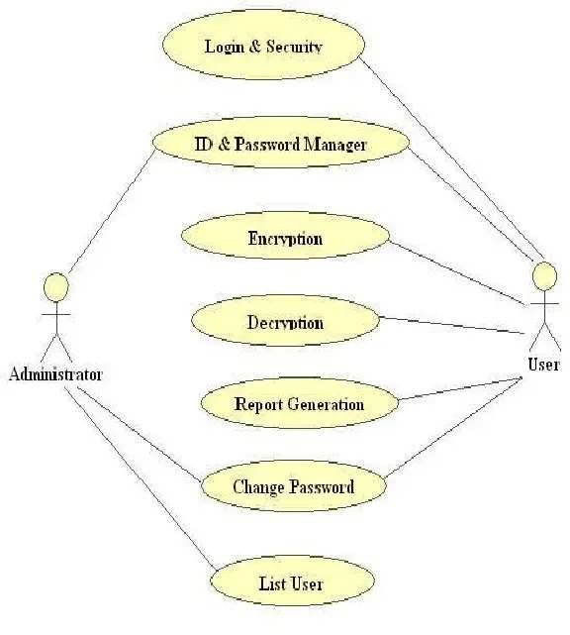
User Case Diagram

Slide 11
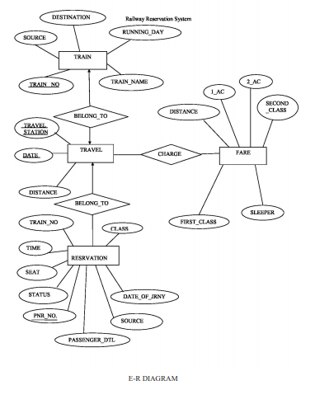
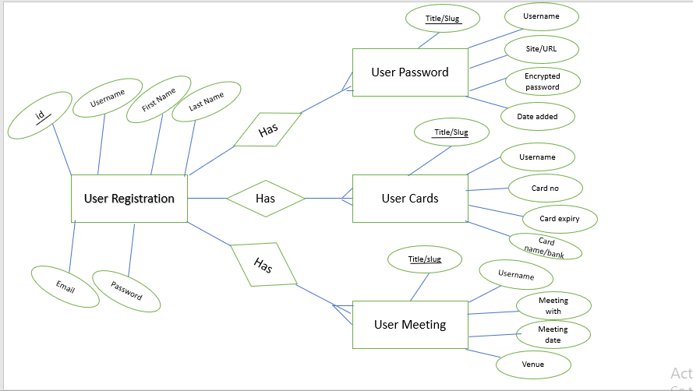
E-R Diagram

Slide 12
SCREEN SHOTS

Slide 13
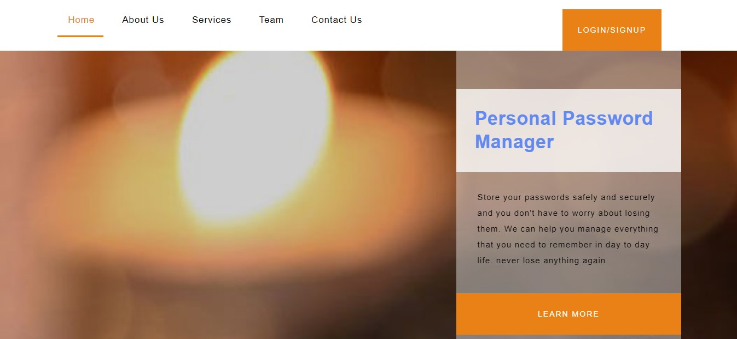
Home Screen of Our Website

Slide 14
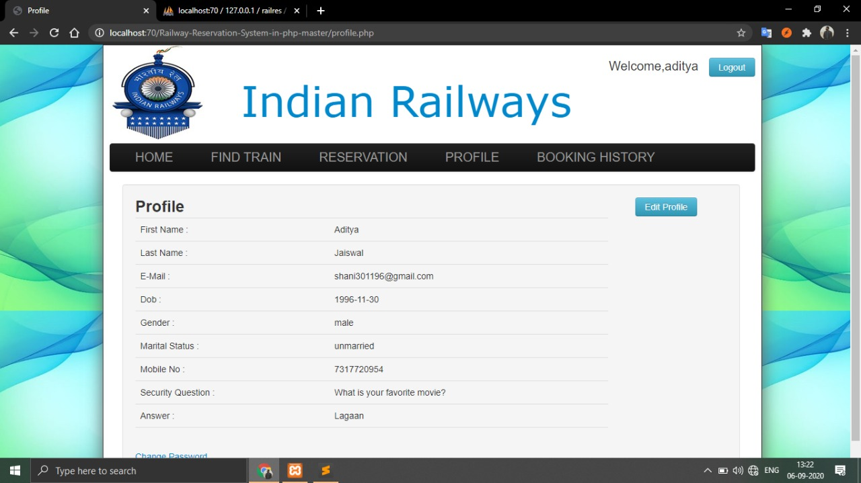
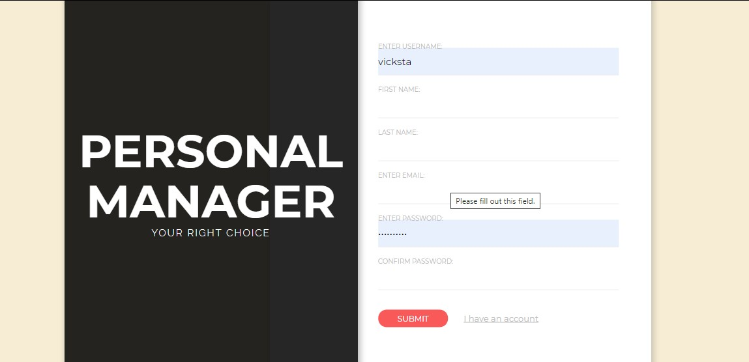
Profile Screen

Slide 15
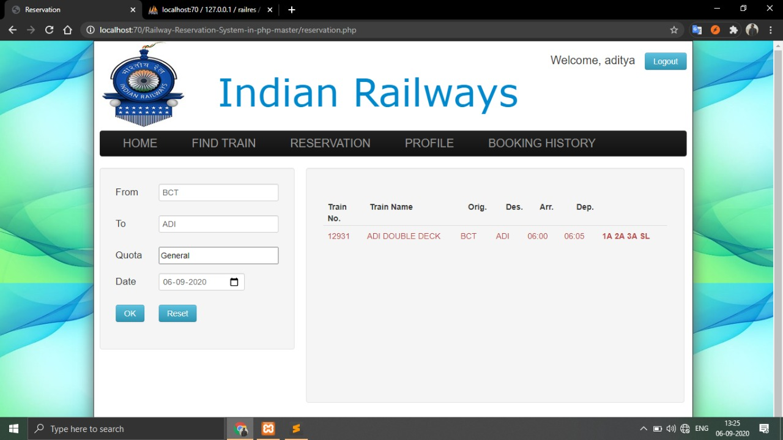
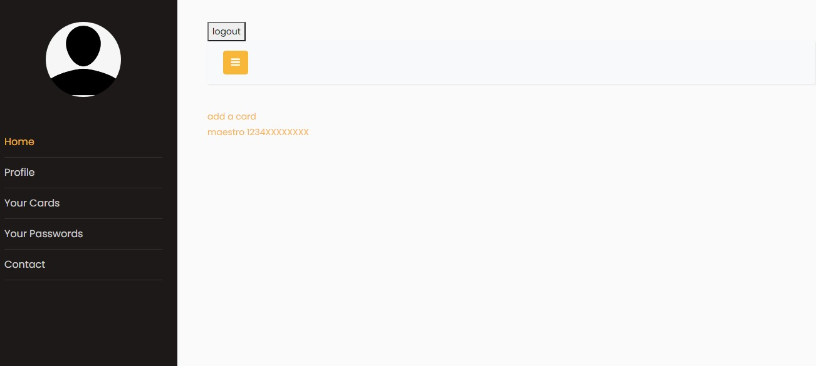
Search Train

Slide 16
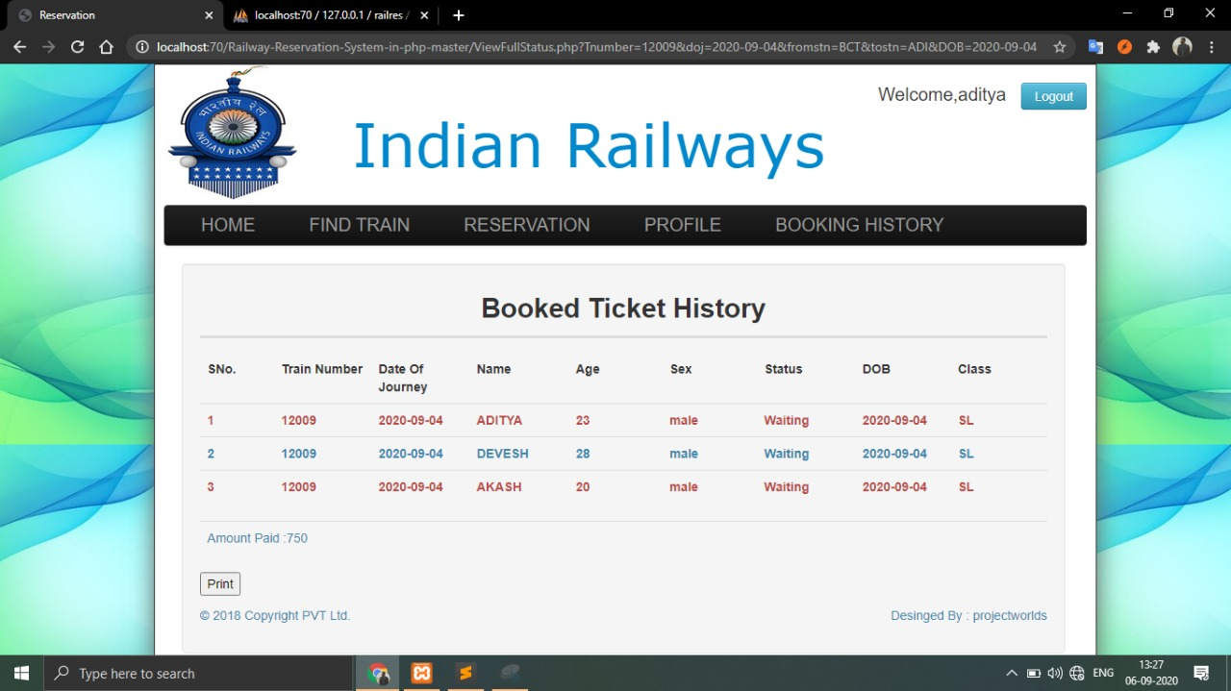
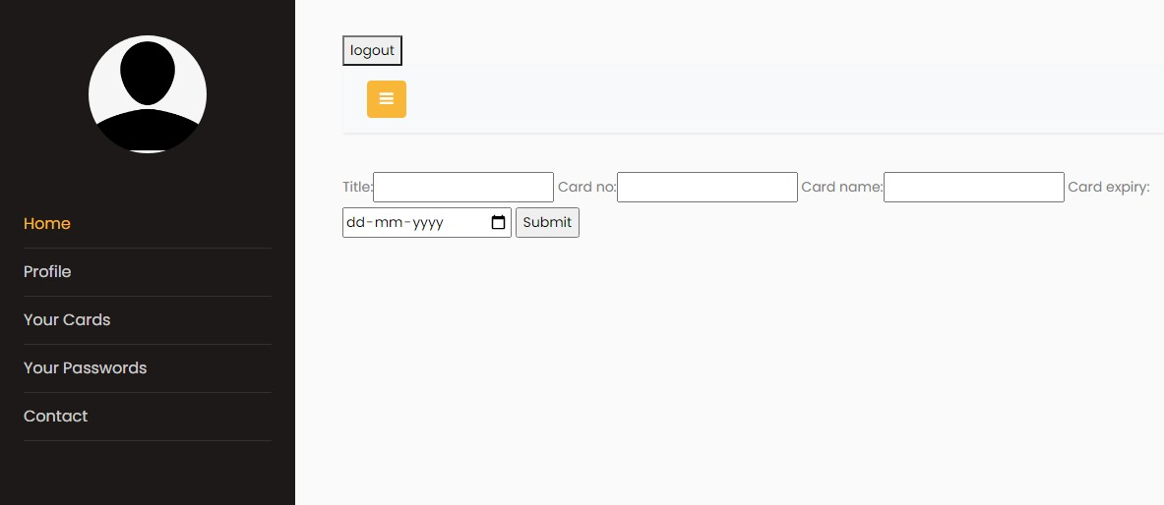
Booked History

Slide 17
Testing
Testing is a process of executing a program with the indent of finding an error. Testing is a crucial element of software quality assurance and presents ultimate review of specification, design and coding.
White-box testing:
White box testing focus on the program control structure. Test cases are derived to ensure
that all statements in the program have been executed at least once during testing and that
all logical conditions have been executed.
Block-box testing:
Black box testing is designed to validate functional requirements without regard to the
internal workings of a program. Black box testing mainly focuses on the information domain
of the software,. deriving test cases by partitioning input and output in a manner that provides
through test coverage. Incorrect and missing functions, interface errors, errors in data structures,
error in functional logic are the errors falling in this category.

Slide 18
Testing Strategies :
A strategy for software testing must accommodate low-level tests that are necessary to verify that all small source code segment has been correctly implemented as well as high-level tests that validate major system functions against customer requirements.
Testing Fundamentals :
Testing is a process of executing program with the intent of finding error. A good test case
is one that has high probability of finding an undiscovered error. If testing is con-
ducted successfully it uncovers the errors in the software. Testing cannot show
the absence of defects, it can only show that software defects present.

Slide 19
Conclusion
Rather than designing manually we have made use of computer as once that data‟s are input
it performs accurate function. There is no chance of fault or miscalculation if the data are
feeded correctly. Use of the computers has solved many problems, which are faced while
manual calculation.
This is not the end but beginning of the versatile, efficient and outsourcing railway reservation
system. This is the one which is Railway Reservation System compatible to all operating system.
By making this we project we made a small footstep towards the path of progress of platform
independent railway reservation system.

Slide 20
References
www.google.com
https://www.w3schools.com/html/
https://www.w3schools.com/css/
https://www.php.net/
https://getbootstrap.com/docs/4.5/layout/overview/
https://www.w3schools.com/php/php_intro.asp
https://www.w3schools.com/php/php_mysql_intro.asp
https://www.irctc.co.in/nget/train-search

